Slide 1

BECE497J PROJECT-1
ACOUSTIC SIGNAL BASED ANALYSIS - FAULT DETECTION AND FAULT LOCALIZATION IN ELECTRICAL MOTORS
FACULTY GUIDE
KALAIVANI S
PROFESSOR GRADE 1
SCHOOL OF ELECTRONICS ENGINEERING
ANURAG SONAR
OM RAVINDRA POTDAR
SOUMITRA MAHASHABDE
1
21BEC0496
21BEC0499
21BEC0631

Slide 2
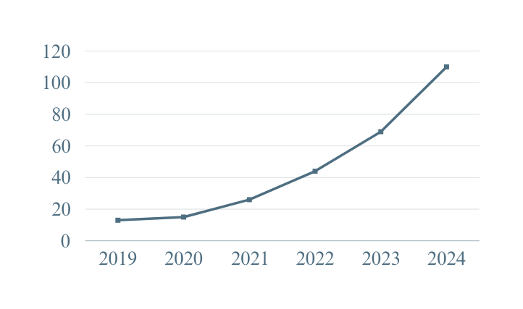

CURRENT STATUS
1D central contour moments
The CAGR (Compound Annual Growth Rate) for EV sales in India is approximately 48% over the last five years.
1D central contour moments is highly sensitive to background noise which affects the accuracy of fault detection, especially in noisy environments like factories or roads.
Methods rely on geometric properties of sound contours, which may not capture the full complexity of the spectral or time-frequency characteristics.
EV Sales (Lacs)
Fourier Transform-Based Methods
Effective for frequency domain analysis but struggle with time-varying signals and distinguishing between noise and fault signals in noisy environments.
Electric Motors
1
70% of industrial machinery in sectors like textiles, steel, and chemicals.
80% of irrigation systems in India for water pumps in farming operations.
Key in appliances, a market growing by 9.1% CAGR from 2023 to 2028.
Spectrogram Analysis
2
Useful for visualizing sound patterns but often interfered with by background noise, making it challenging to isolate fault-related signals in complex settings.
3
2

Slide 3
MOTIVATION
01
Non-Invasive and Cost-Effective Monitoring
Traditional fault detection methods like vibration analysis or thermal imaging often require physical sensors to be placed on the motor, which can be invasive or impractical for continuous monitoring.
02
Applicability to Various Fault Types
Conventional techniques like vibration analysis, are highly effective for identifying mechanical issues but often face limitations when it comes to detecting electrical faults or other specialized problems.
03
Sustainability and Energy Efficiency
Undetected faults in motor operation can result in significant energy losses, which not only drive up operational costs but also increase carbon emissions, contribute to resource wastage, and strain energy infrastructure, amplifying the overall environmental impact.
04
Growing Industry Demand
The demand for predictive maintenance is rapidly increasing across industries, yet many companies continue to rely on outdated maintenance strategies because of the limited availability of solutions.
3

Slide 4

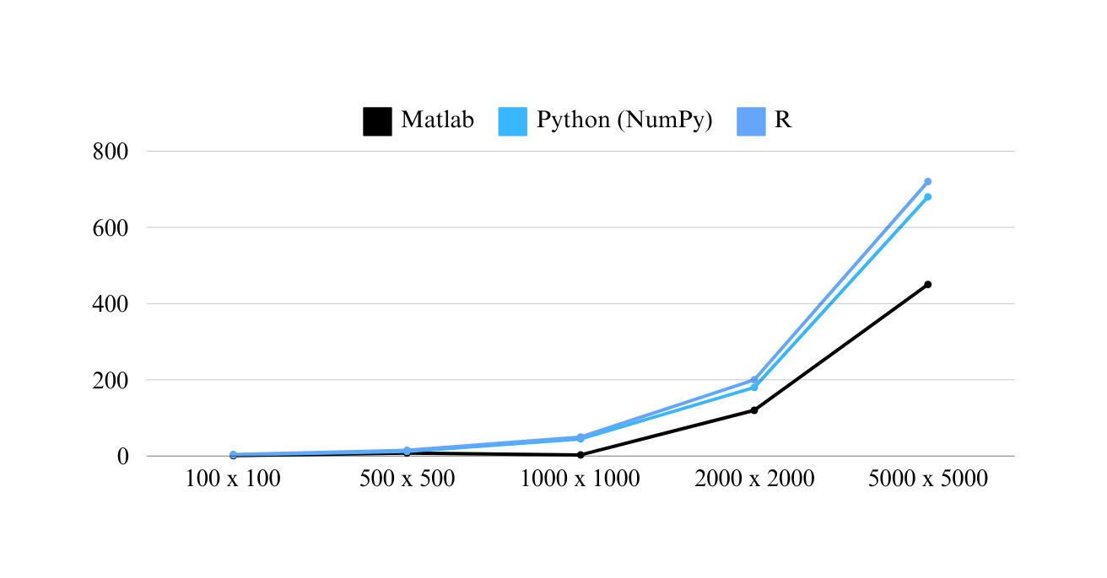
SOFTWARE
Version - MATLAB R2024a
MATLAB consistently demonstrates faster execution times compared to Python, R especially for larger matrix sizes, indicating superior efficiency for matrix computations.
MATLAB is a software environment used for numerical computation, data analysis, and algorithm development, especially in engineering and science. It also provides powerful tools for visualizing data and creating simulations with its specialized toolboxes.
Microseconds
Data Matrix
4

Slide 5
OBJECTIVES
Implement Signal Processing
Design a System
Identify Key Features
Design a software interface to process and visualize these acoustic signals for further analysis.
Detect and characterize fault-specific acoustic patterns related to issues like bearing failures and rotor imbalances.
Apply algorithms to filter noise and enhance relevant fault features in the acoustic data.
Develop Deep Learning Model
Validate the System
Promote Sustainable Practices
Create models to classify motor faults and determine their location based on acoustic signals.
Test the system extensively across different motor types and conditions to ensure its reliability and accuracy.
Reduce energy waste and extend motor life through early fault detection, supporting environmental and operational sustainability.
5

Slide 6
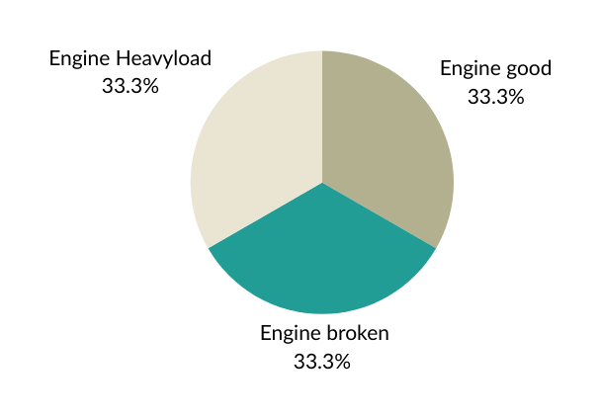
Dataset Composition
METHODOLOGY
Preprocessing
Data cleaning
Removed any irrelevant data (e.g., noise or silent periods).
Checked for missing values, inconsistencies, or outliers.
The IDMT_ISA_ELECTRIC_ENGINE dataset that was recorded at Fraunhofer Institute for Digital Media Technology (IDMT).
Normalization
The dataset consists of recordings of the electric engine in 3 operational states, “good”, “heavy load” and “broken” were provoked by a change of supply voltage and loading weight leading to a change of the operating sound.
Noise Filtering and normalize signal amplitude to ensure consistency
The dataset consists of recordings of the electric engine plus the following background noise types:
Signal Segmentation
Noiseless
People talking
White noise
Atmospheric sounds from the environment
Stressed system
Divided the data signals into 3-second segments for to make fault detection easier.
6

Slide 7

METHODOLOGY
01
Feature Extraction
02
Fault Classification
Time-Domain Features
PRIMARY CLASSIFIER
VALIDATION MODEL
A
1D CNN
SVM
A
RMS
Mean
Variance
Crest factor
Energy
Employs convolutional layers to learn patterns from the extracted features, classifying motor states (good, broken, heavy load).
Efficient in automatically learning key fault patterns from raw audio data, ideal for complex classification tasks without manual feature engineering.
Works well on smaller datasets with clear distinctions between classes, serving as a traditional method for comparison against deep learning models.
Analyze signal power, variability, and peaks to detect motor faults.
Frequency-Domain Features
B
Random Forest
Dominant Frequency
Extracted using FFT, identifying main frequency components related to mechanical failures.
Combines multiple decision trees for robust performance on noisy data
7

Slide 8
RESULTS
Feature
Extraction
Initial Expectations
Anticipated Accuracy
Steps in
Progress
Successfully extracted important features like RMS, mean, variance, crest factor, energy, and dominant frequency from our audio signals. This gives us a solid base for classification.
Though the classifier is not fully implemented the classifier, based on what we’ve studied and other research papers, we expect the deep learning model (1D CNN) to give good results.
Although at this stage, we can’t report exact values, we’re hoping for good classification accuracy after the final testing.
We plan to use SVM and Random Forest to provide benchmarks for comparison and validation.
Our current focus is completing the classifier implementation, running it, and analyzing the results, which we believe will be promising based on the features we’ve chosen and the methods we’re using.
8

Slide 9
CONCLUSION
01
Focused on analyzing acoustic signals for fault detection and localization in electric motors.
02
Extracted key audio features such as RMS, mean, variance, and dominant frequency.
03
Integrated deep learning techniques for improved fault classification accuracy.
04
Classifier implementation is ongoing, with a strong foundation established.
05
Next steps include testing and optimizing the model for real-world applications.
06
Aim to reduce downtime and costs in industrial settings through predictive maintenance.
9

Slide 10
SCOPE FOR IMPROVEMENT
01
Explore Additional Features
02
Test with More Classifiers
Can implement other features like wavelet transforms or statistical moments to capture more details in the signals.
Trying out different classifiers like SVM, Random Forest, or combining multiple models could give better results.
03
Real-Time Implementation
04
Larger Dataset
Eventually, we could aim to make the system work in real-time, improving the efficiency of detecting faults as they happen.
Collecting more data or using data augmentation techniques like adding noise could make the model more robust and avoid overfitting.
05
Optimize the Model
06
Enhance Noise Reduction Techniques
Work on optimizing the model to make it faster and more memory-efficient, so it can run on lower-end hardware or embedded systems.
Improve the system’s performance in noisy environments by exploring advanced noise filtering techniques or adaptive filters, which could enhance fault detection accuracy in real-world conditions.
10

Slide 11
Enhanced Safety
01
Early motor fault detection prevents equipment failures and accidents, improving workplace safety.
Energy Efficiency
02
Detecting motor issues early allows for better performance, reducing energy waste and carbon emissions.
SOCIAL
IMPACT
Economic Savings
03
Predictive maintenance lowers repair costs and reduces downtime, boosting productivity in industries.
Environmental Impact
04
Optimized motor operations reduce energy consumption and contribute to sustainability goals.
Technological Progress
05
This project utilizes machine learning to improve predictive maintenance, enabling smarter, data-driven decision-making in industries.
11

Slide 12
SUSTAINABLE DEVELOPEMENT GOALS
09
11
12
INDUSTRY, INNOVATION, AND INFRASTRUCTURE
RESPONSIBLE CONSUMPTION AND PRODUCTION
SUSTAINABLE CITIES AND COMMUNITIES
Acoustic analysis and machine learning improve fault detection, driving innovation in diagnostics.
Automated detection reduces downtime, enhancing reliability in industries and vehicles.
Early fault detection ensures safer vehicles, contributing to sustainable urban mobility.
Noise-resilient systems support the maintenance of safe and efficient public transport.
Early fault identification extends machine lifespan, optimizing resource use.
Automated diagnostics lower costs and improve production efficiency through better machine management.
12

Slide 13

TIMELINE
August
September
October
November
Project
Planning
Title / Abstract Finalization
Timeline Finalization
Data Acquisition
Pre-processing
Signal Segmentation
Fault Detection
Implementation
Feature Extraction
Fault Classification
Fault Classification
Localization
Validation
Project Report
Results
Faculty Review
Review 1
Testing
Final Review
13

